Slide 1

Trust in Real Time: The 2026 Reputation Playbook Five Insights from Echo’s Client Advisory Board

Slide 2
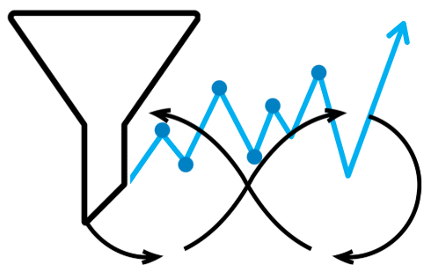
Why This Matters Now
The World Has Accelerated
Decisions once measured in quarters are now made in moments
Artificial intelligence, political volatility, and social division are rewriting the rules of reputation
Echo’s Client Advisory Board convened to explore how organisations can maintain legitimacy and trust and manage risks - in real time
The traditional marketing funnel is dead; replaced by continuous feedback loops
Marketing is now prediction, not persuasion
“Reputation and Trust need to be measured like a living asset” – Echo Client Advisory Board Member

Slide 3

1. In the new world, politics drives economics
Geopolitical volatility is now a core business risk and reputations rise or fall on how leaders respond
Political agendas increasingly drive market outcomes
Organisations must anticipate shocks and adapt policy as strategy
Echo’s Advisory Board urges focus to “understand political actors and geopolitics so as to understand policy”

Slide 4

2. Crisis is a Chronic Condition
We’re beyond perma-crises now
We’re in a ‘chronic’ crisis era – crises are constant now but manageable, not curable
Bad things often happen to protect ‘good’ reputations
Reputation management is ‘continuous care’
“Readiness / preparedness is the new resilience” – Echo Client Advisory Board Member

Slide 5

3. Gen Z: Future-Ready or Future-Risk
Mind the reality disconnect
Gen Z represents both promise and paradox - vocal about values but inconsistent in behaviour
Their influence is growing, yet their actions (from crypto enthusiasm to cheap-flight habits) reveal the gap between ideals and decisions
“Bridging the Values–Behaviour Gap is the next trust frontier” – Echo Client Advisory Board Member

Slide 6

4. AI & the Trust Gap
Untrustworthy – yet unstoppable
AI democratises access, empowering a new DIY generation of creators
But unverified data breeds misinformation and mistrust and creates risk at speed
When intimacy declines and self-interest rises, trust depreciates. The new differentiator is empathy - Trust’s human face
When combined with human judgement, AI unlocks the 3 I’s: Imagination + Integration with Integrity
“AI won’t replace judgement - it will test it.” - Echo Client Advisory Board Member

Slide 7

5. From Insight to Foresight
Risk Ownership to Consequence Clarity
As the world accelerates, leadership must be measured in trust, not time
Are leaders truly accountable - legally, ethically, reputationally - for the choices they make today?
The advantage now lies in foresight - Echo helps leaders see tomorrow’s issues and risks today with the intelligence to interpret early signals and turn insight into preparedness
The evidence is there - it’s how we use it that matters
Echo’s Client Advisory Board consensus: “The future of trust depends on how well leaders close these gaps - between words and actions, technology and judgement, decision and accountability.”

Slide 8




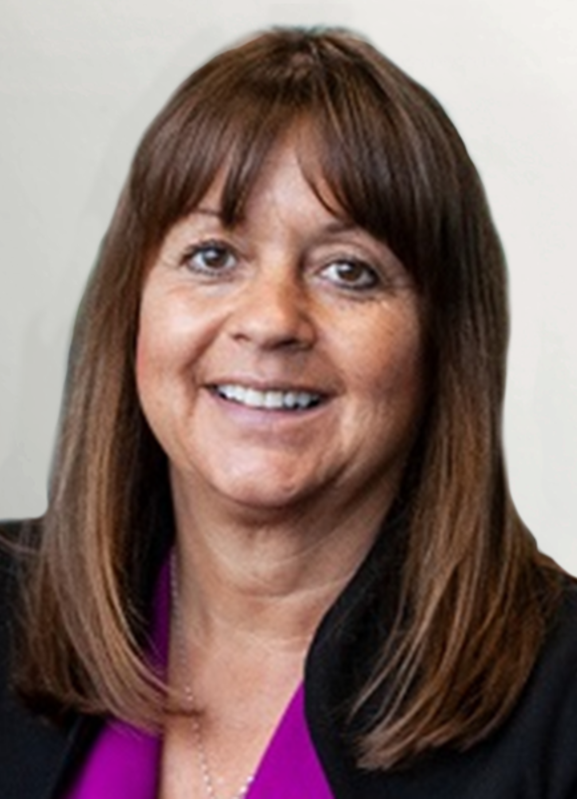
Echo Client Advisory Board Voices
We need to measure reputation and trust as a living asset
Bridging the Values-Behaviour Gap is the next trust frontier
AI won’t replace judgment - it will test it
Readiness / preparedness is the new resilience
Andrew Whyte
Advisory Board Member
Professor
Anne Gregory
Advisory Board Member
James Tutt
Advisory Board Member
Kai Boschmann
Advisory Board Member

Slide 9







Building Future-Ready Organisations with Evidence and Insight
AGILITY
to move fast and think deeply
LEGITIMACY
to act with purpose and permission
CONFIDENCE
to lead through uncertainty
RISK READINESS
to manage the next disruption
FUTURE FOCUS
to anticipate shifts
LANGUAGE SENSITIVITY
to communicate without polarising

Slide 10
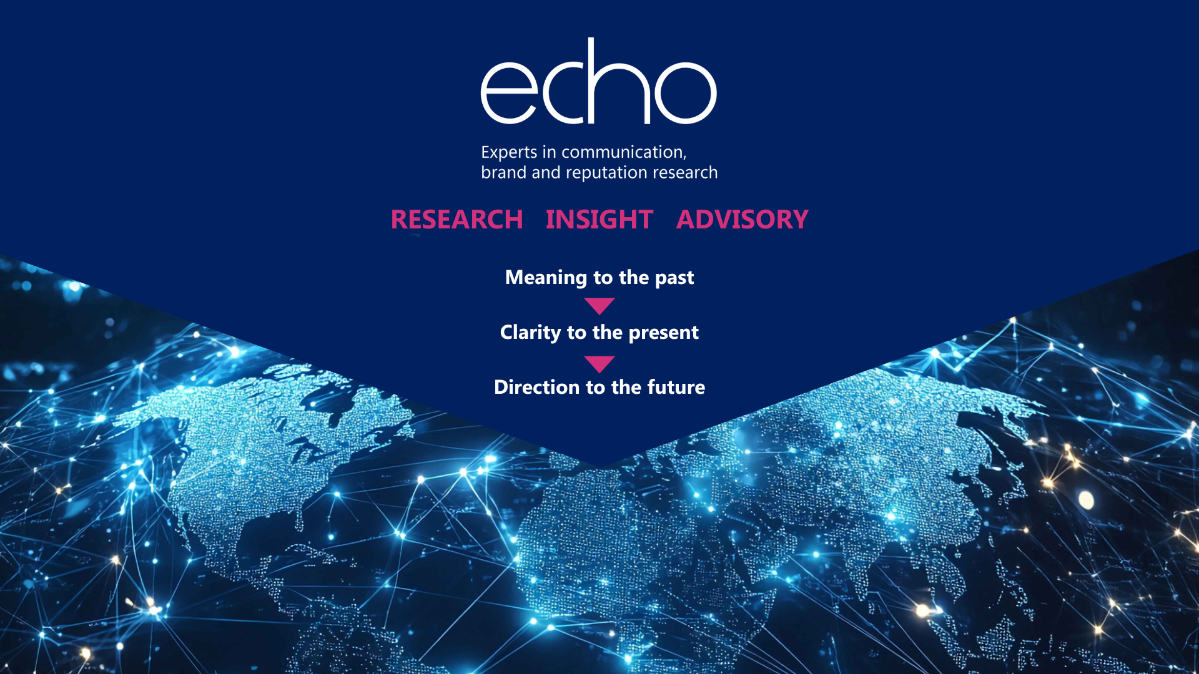
sandra.macleod@echoresearch.com
enquiries@echoresearch.com

